Slide 1



1202007
Internship record
Statistics
MotorCarCare
Presented by: slidesdocs
Department of Computer Science
STUDENT SOCIAL PRACTICE REPORT
2025

Slide 2


Alaa Dar-Yaqoub
Ayham Jameel
1202007
1190935

Slide 3
Contents
01
02
03
04
Project Overview
Goals & Objectives
Problem & Solution
System Features

Slide 4
Contents
05
06
07
08
System Architecture
Implementation &Testing
System Features
Technologies Used

Slide 5
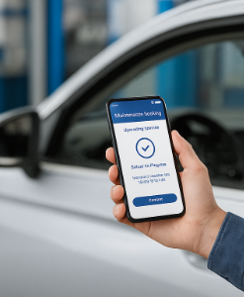
01
Project Overview
Many car owners struggle with booking maintenance using traditional methods.
companies face difficulties organizing appointments and customer data.
MotorCarCare simplifies booking, tracks service status, and sends real-time updates.
The platform is accessible via both mobile and web, improving convenience and reach.

Slide 6
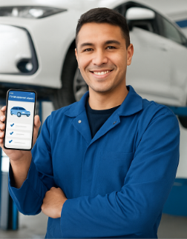
02
Goals & Objectives
Make car maintenance easier for car owners and companies .
Reduce waiting times and manual errors.
Let users track repair status.
Digitally organize appointments and service history.
Ensure access via both web and mobile apps.

Slide 7

03
Problem
Car owners often face delays, long waiting times, and a lack of updates when booking maintenance using traditional methods.
Companies rely on manual methods, making it difficult to manage appointments, track customer data, and communicate efficiently.

Slide 8
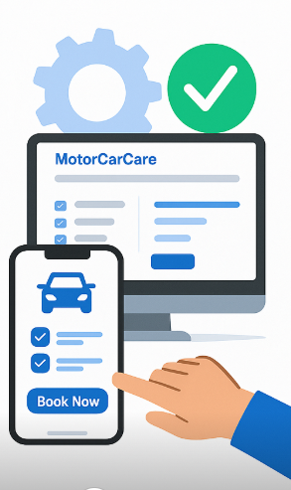
04
Solution
MotorCarCare is a smart digital platform for both customers and workshops.
It streamlines appointment booking, service tracking, and real-time notifications.
Available on both mobile and web apps, making car maintenance more organized, transparent, and accessible.

Slide 9


System Features
05
Customer Features
Company Features
View customer details and service records
Accept or reject bookings
Update repair statuses and payments
Receive and handle reported issues from users
Book car maintenance appointments easily
Track service status in real-time
Access full service history
Receive updates and alerts
Report issues to the company directly

Slide 10






06
Technologies Used
Mobile App
Web App
Flutter: For building cross-platform apps
Dart : Programming language
Firebase : Real-time database and authentication
HTML, CSS, Bootstrap: Interface design
JavaScript: Frontend interactivity and dynamic behavior
PHP: Server-side logic

Slide 11
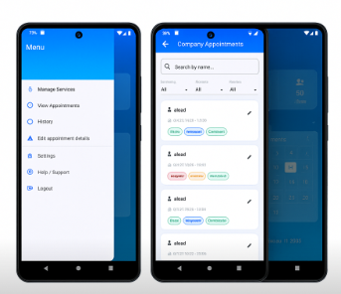
07
Implementation
Company – View Appointments

Slide 12
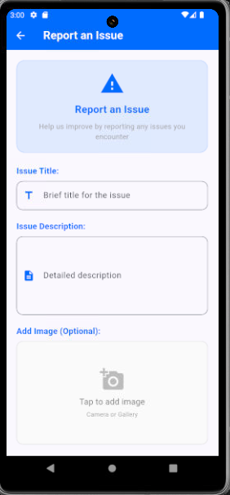
08
Implementation
Report Issues – Customer

Slide 13
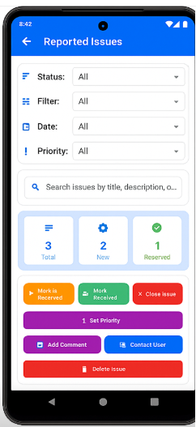
09
Implementation
Company - Reported Issues

Slide 14
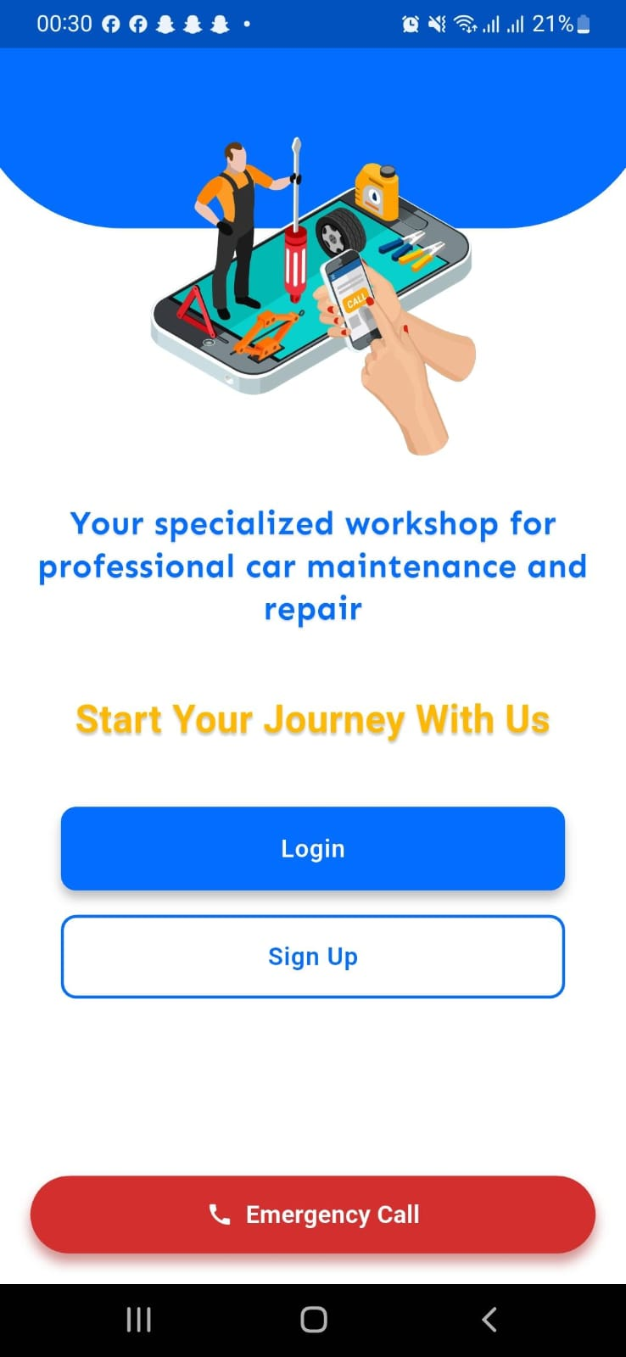
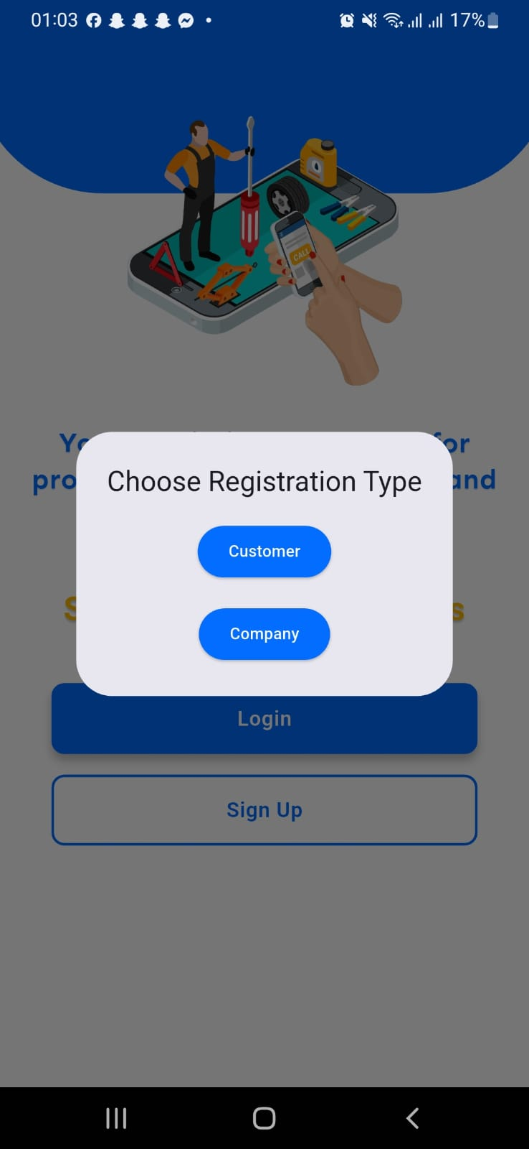
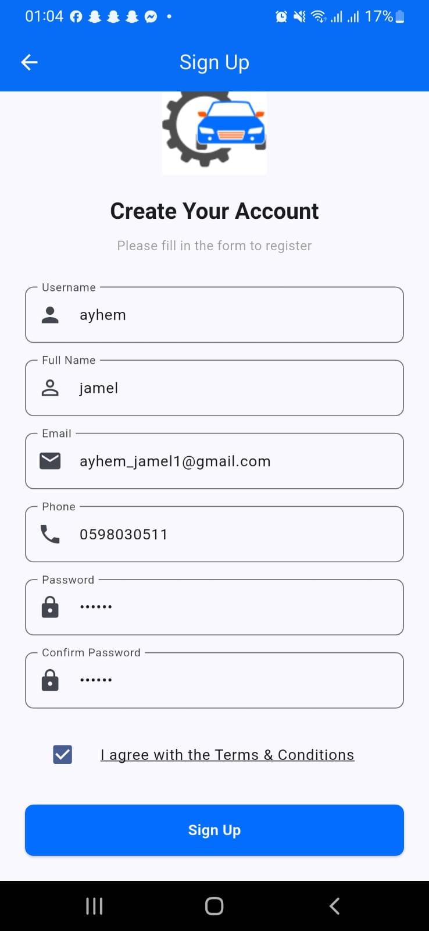
10
Test 1: Customer Sign Up

Slide 15
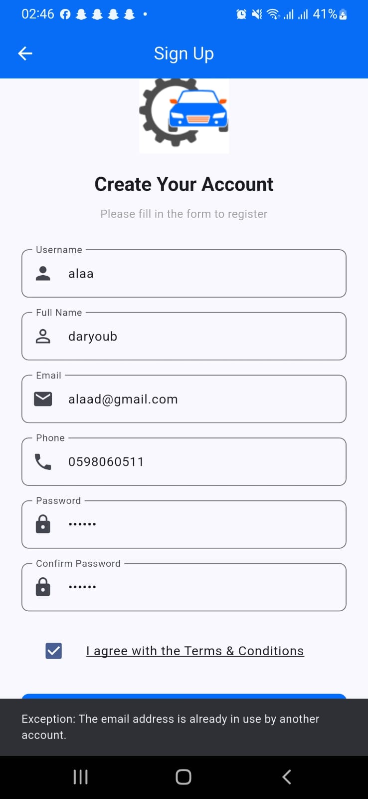
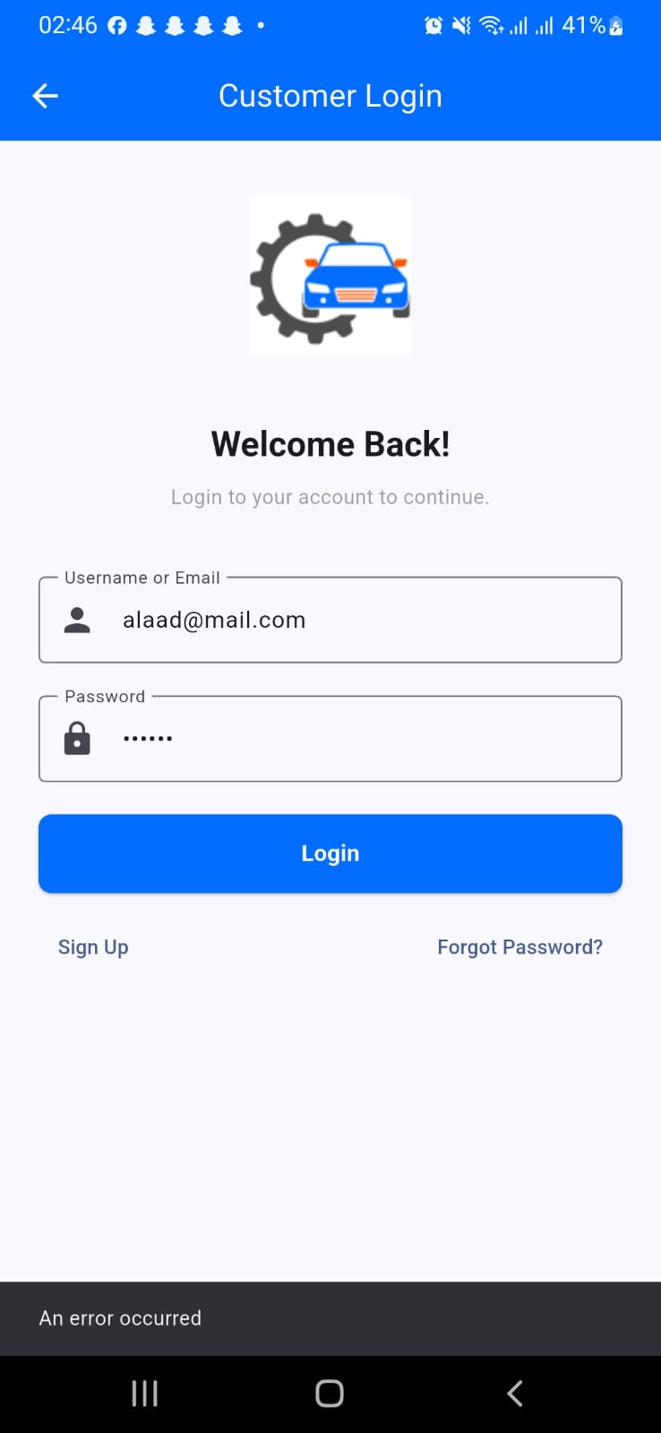
11
Test 2: Customer Login Validation

Slide 16
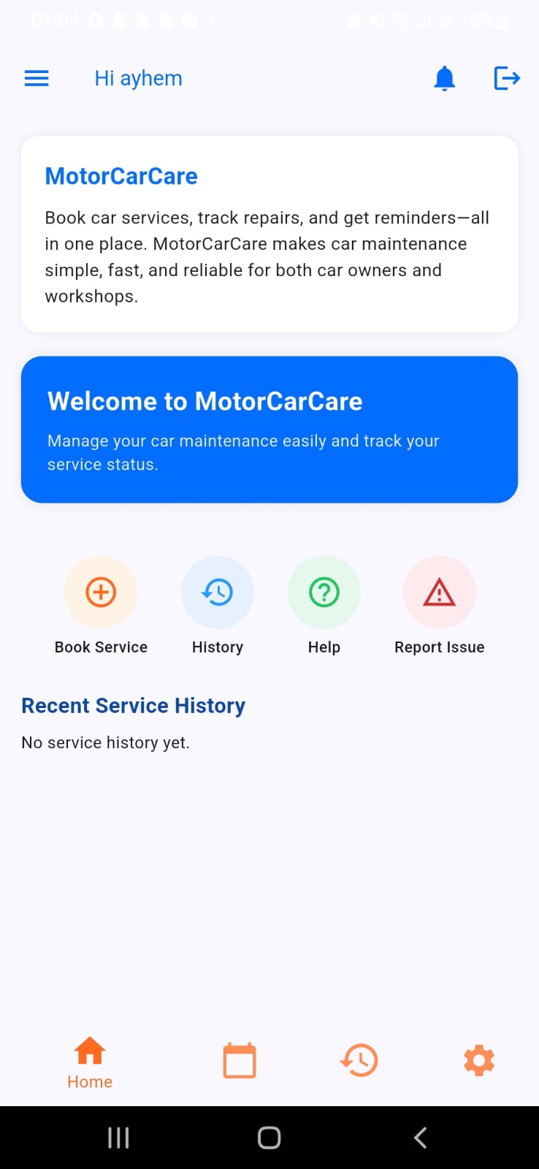
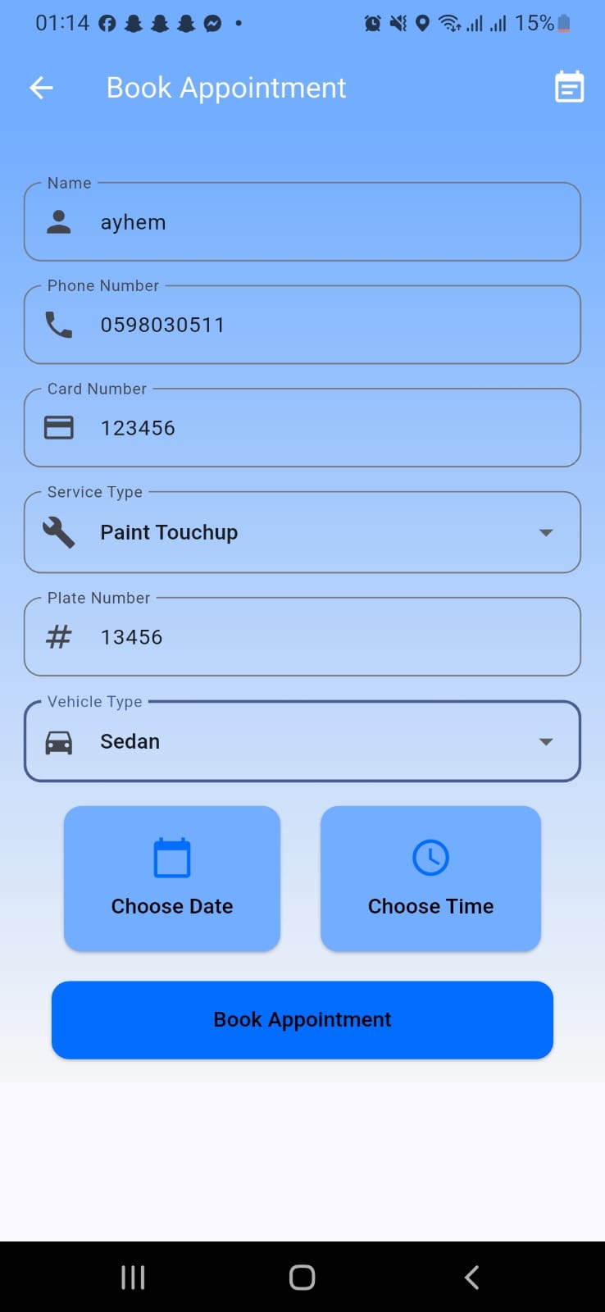
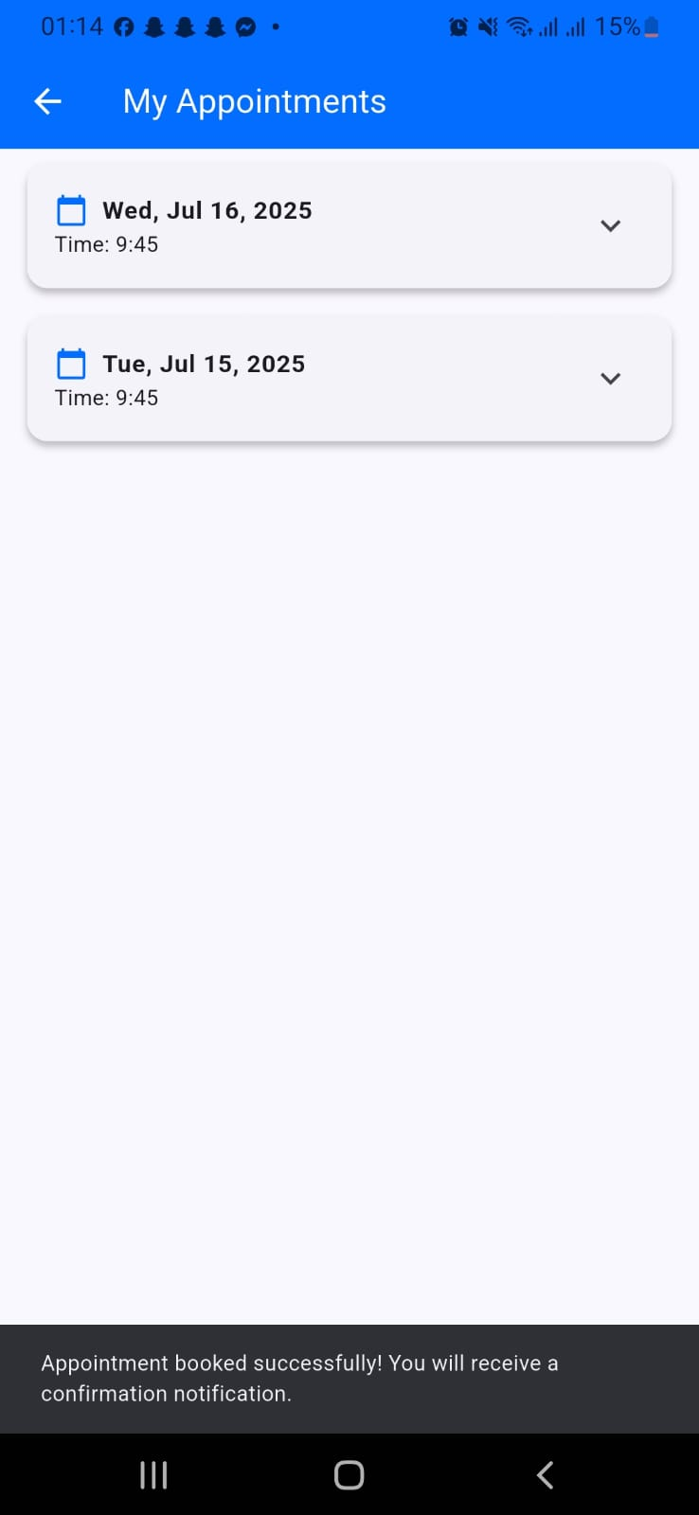
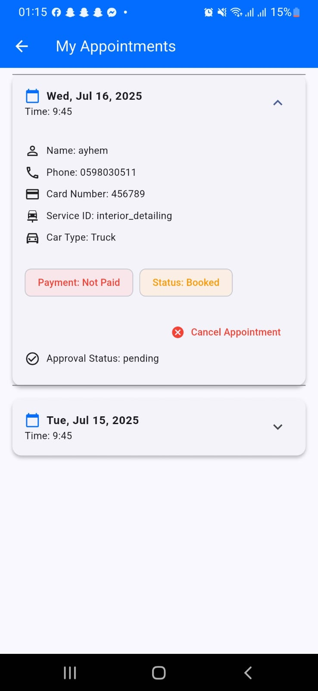
12
Test 3 : Booking & Viewing Appointments

Slide 17
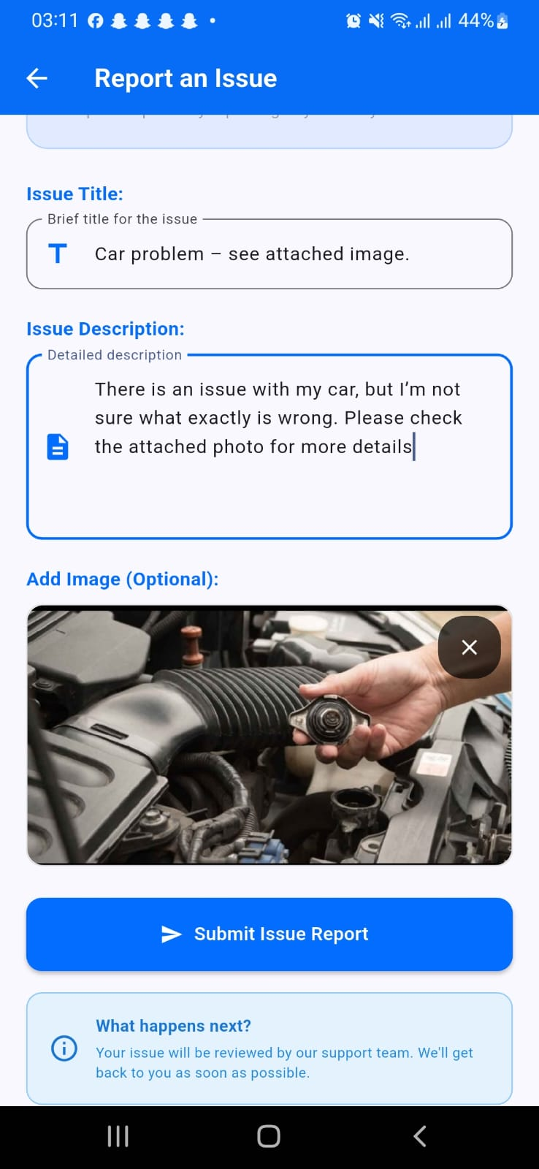
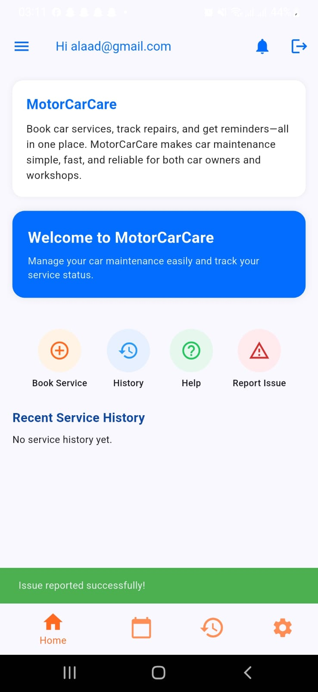
13
Test 4: Report an Issue (Customer)

Slide 18
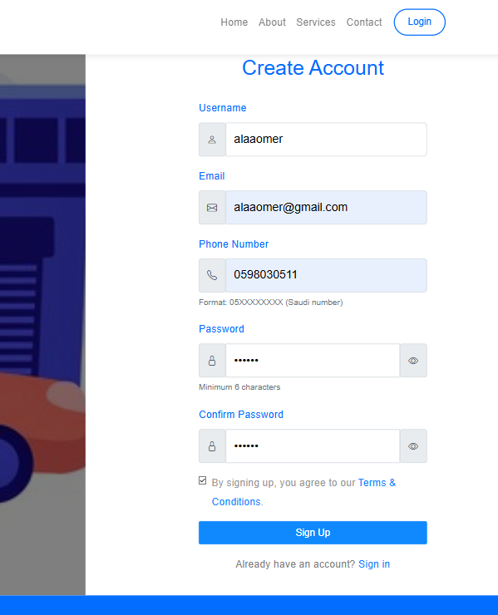
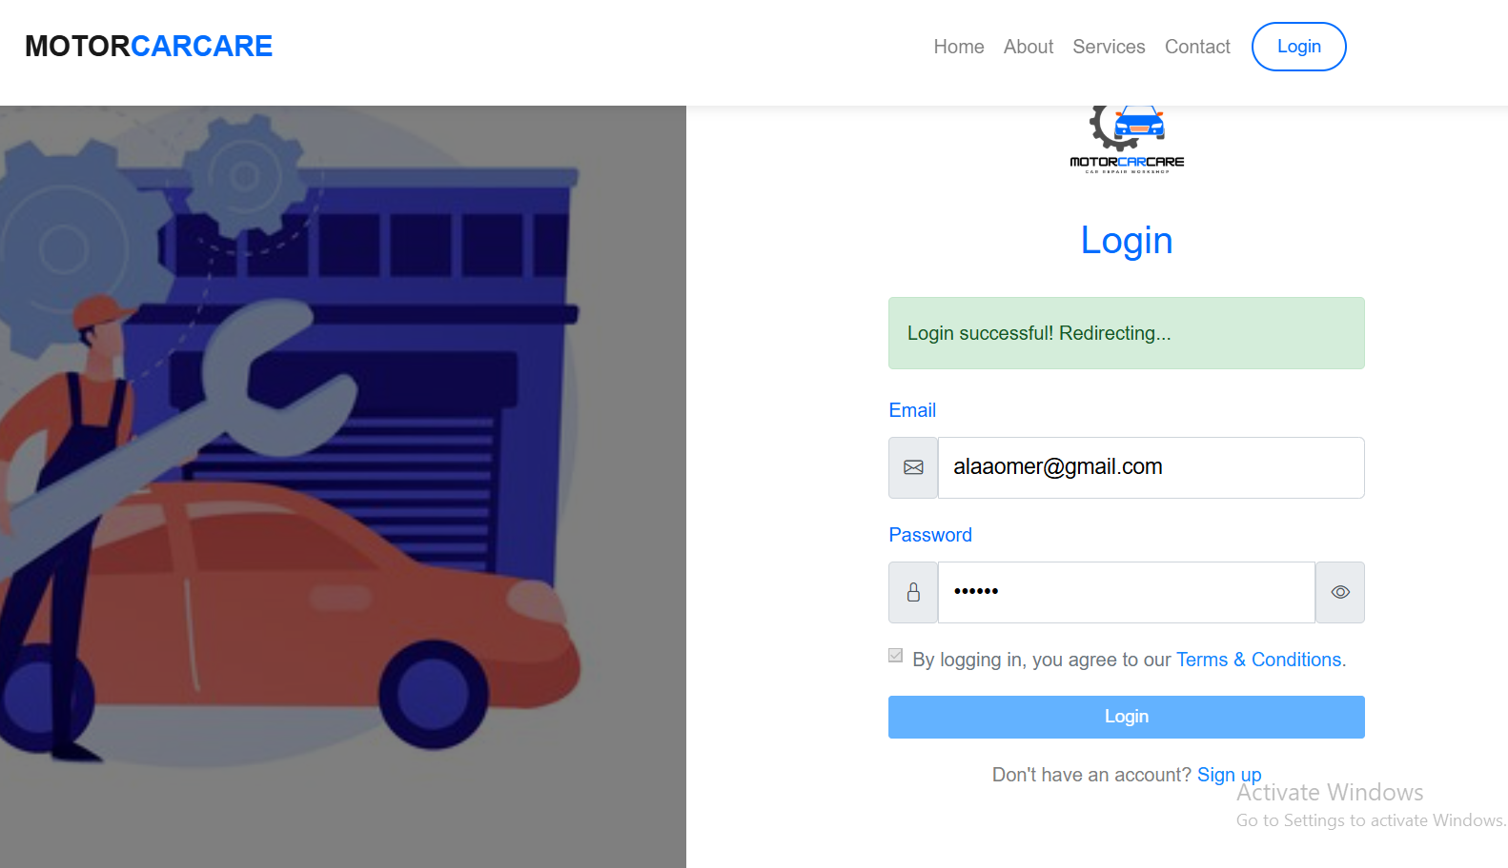
14
Test 5: Web Registration & Login

Slide 19
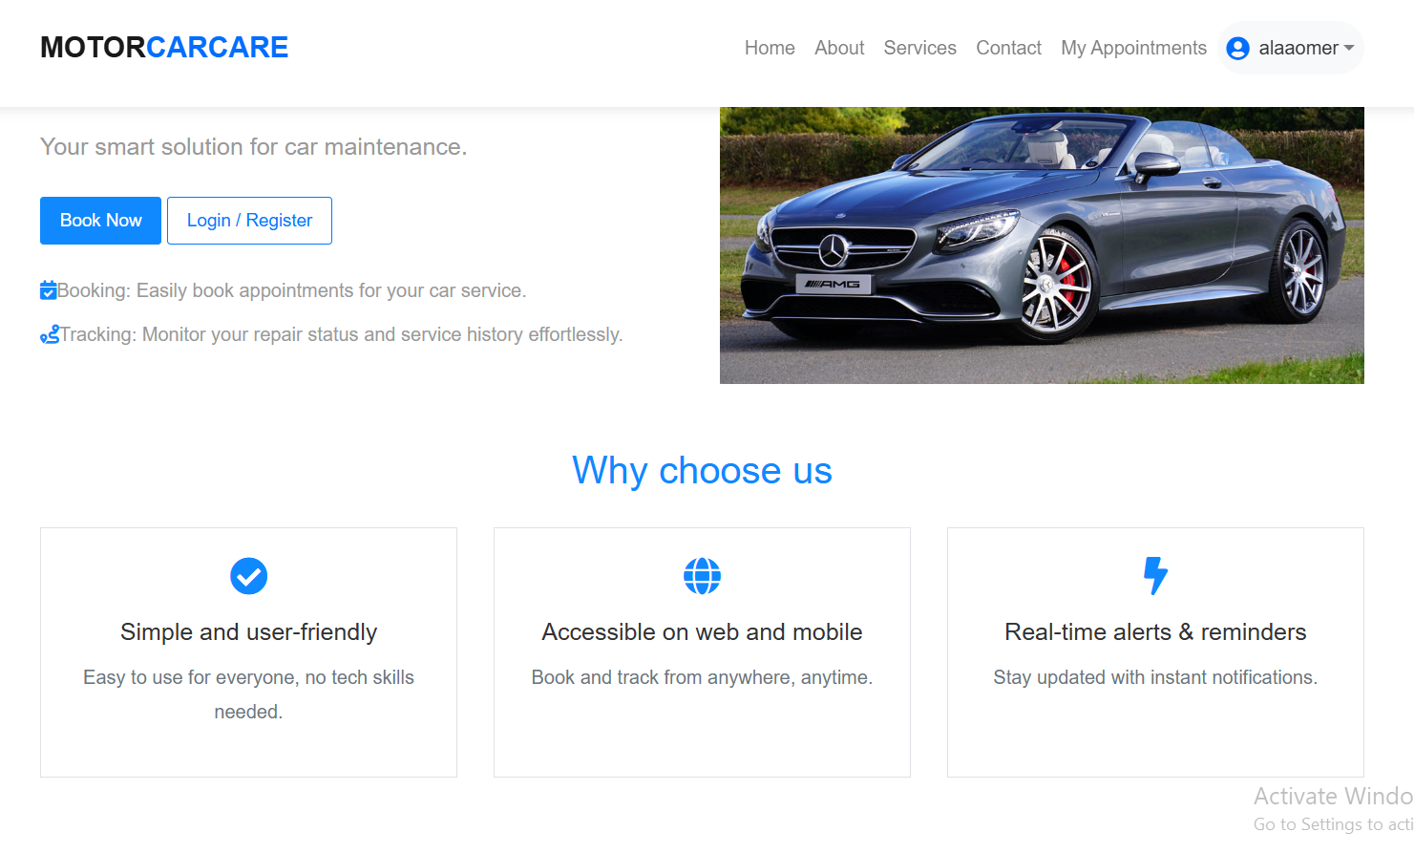
15
Test 6: Web Landing Page

Slide 20
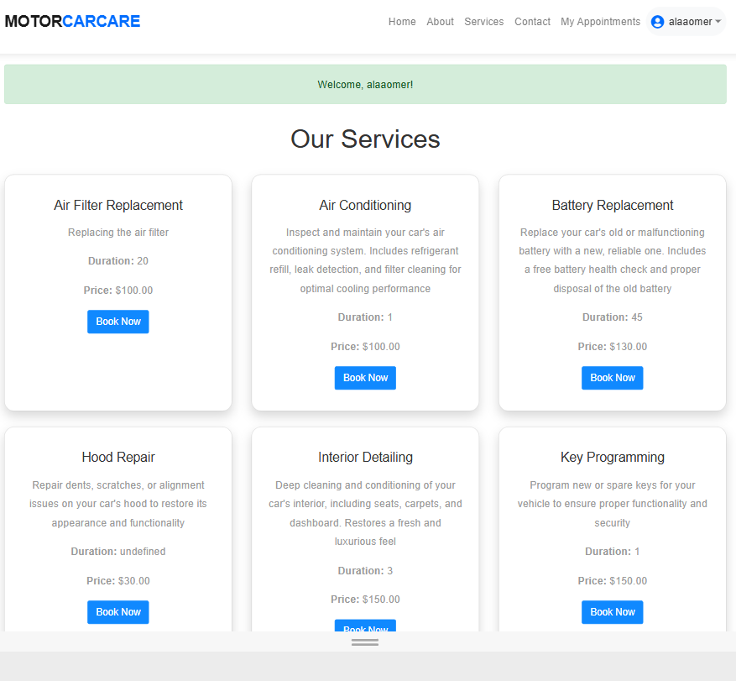
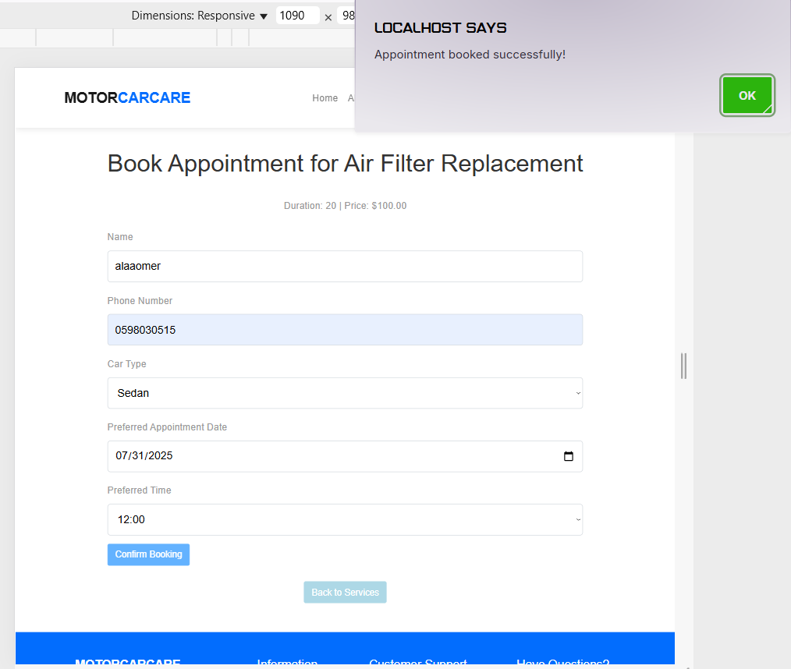
16
Test 7: Booking a Service on the Web

Slide 21
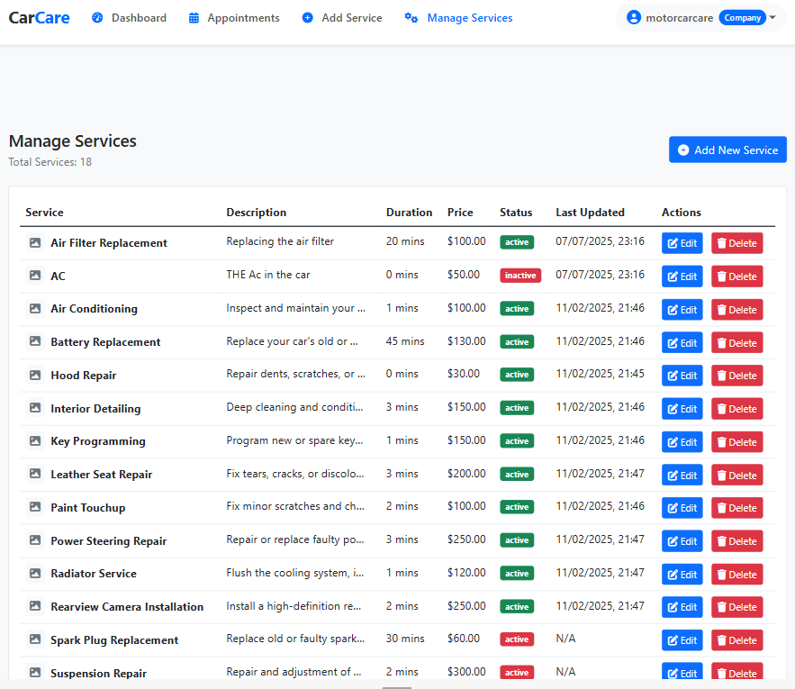
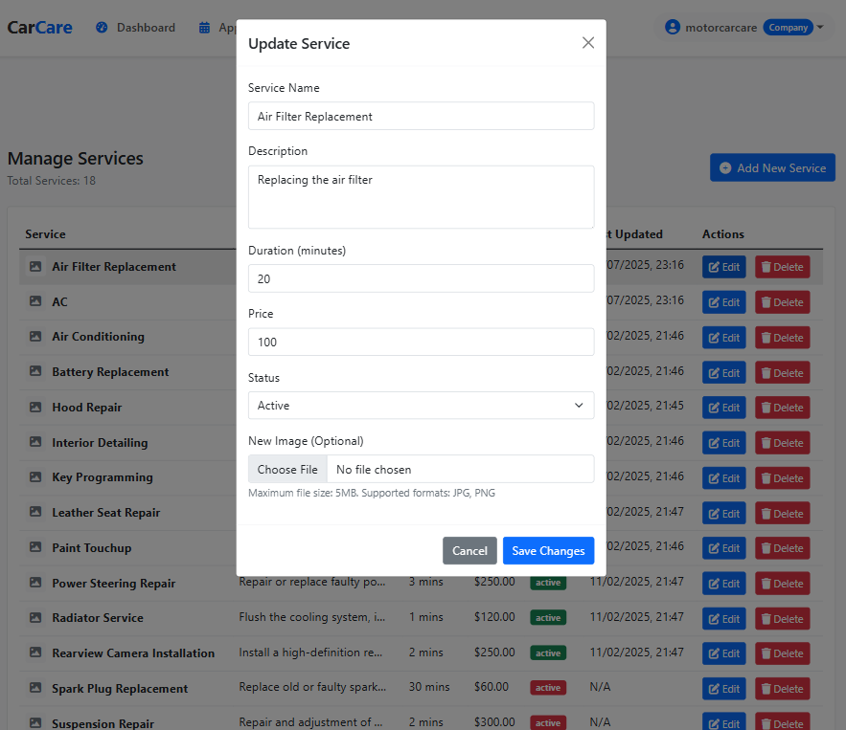
17
Test 8: Service Management Panel

Slide 22
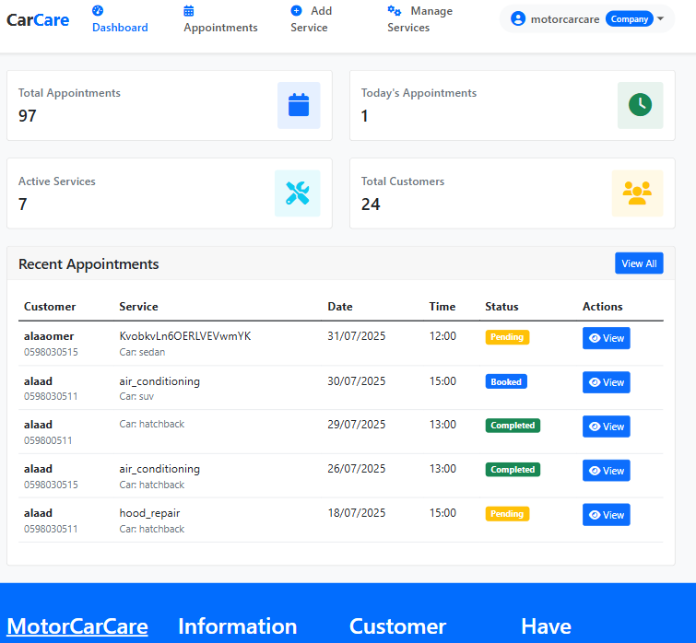
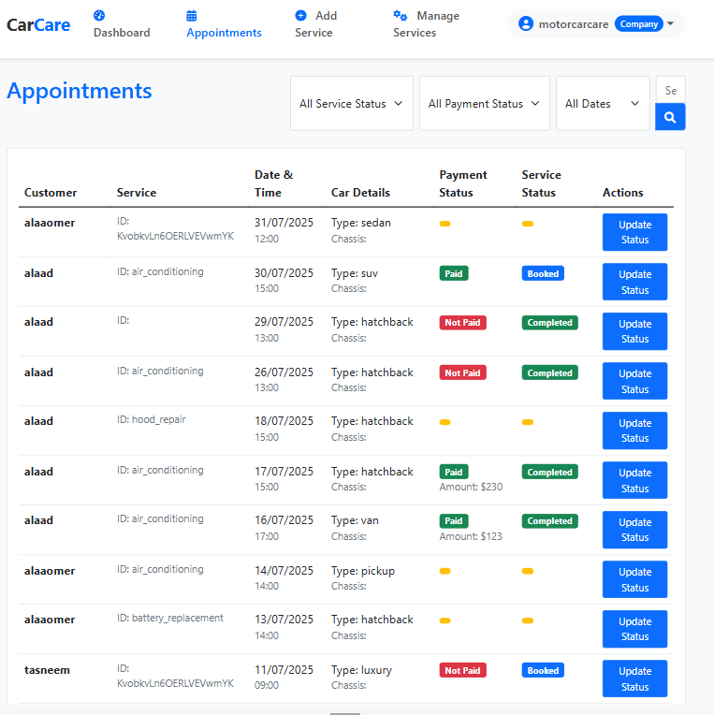
18
Test 9: Admin Dashboard – Appointment & Service Tracking

Slide 23
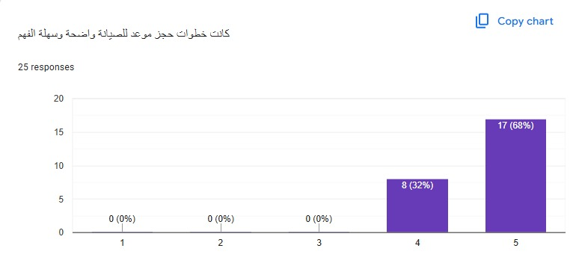
19
UX Survey Result – Booking Process
The booking process was rated highly by users.
68% rated it 5 – Excellent
32% rated it 4 – Very Good
0% gave a rating below 4
Indicates clear, simple, and user-friendly steps.

Slide 24

20
Future Work
AI Integration – Smart issue detection
Online Payments – Pay directly in-app
Chatbot Assistant – Help users book services
Analytics – Insights for workshops
Multi-language Support – Reach more users
Service Reviews – Rate and improve services

Slide 25


Internship record
Statistics
THANK YOU
Thank you for
STUDENT SOCIAL PRACTICE REPORT

